Slide 1


Chemical bonds in coordination compounds
Al-Farabi Kazakh National University
Faculty of Chemistry and Chemical technology
Department of General and Inorganic Chemistry
PhD Bakhadur Askar

Slide 2

Introduction to coordination bonding
Coordination compounds consist of a central metal atom or ion surrounded by ligands, which are ions or molecules that donate electron pairs.
Bonding Characteristics:
The metal center acts as a Lewis acid (electron pair acceptor).
The ligands act as Lewis bases (electron pair donors).
The resulting coordinate covalent bond forms when both electrons come from the ligand.
Example:
$$\left[Cu\left(NH_{3}{\left.)\right.}_{4}{\left.]\right.}^{2+}=Cu^{2+}+4NH_{3}→\left[Cu\left(NH_{3}{\left.)\right.}_{4}{\left.]\right.}^{2+}\right.\right.\right.\right.$$
Each NH₃ donates a lone pair to Cu²⁺ forming four coordinate bonds.

Slide 3
Types of chemical bonds in coordination compounds
Ionic Bonds
  Between metal ion and counterions (e.g., Cl⁻ in [Co(NH₃)₆]Cl₃).
  Hold the complex salt together electrostatically.
Coordinate Covalent Bonds
  Between metal center and ligands via lone-pair donation.
  Characterized by σ and π interactions.
π-Backbonding (Synergic Bonding)
  Metal donates electrons from d-orbitals into π* orbitals of the ligand.
  Strengthens metal–ligand interaction (important for CO, CN⁻ ligands).
Hydrogen Bonds and Secondary Interactions
  Weak interactions that influence geometry, solubility, and reactivity.

Slide 4


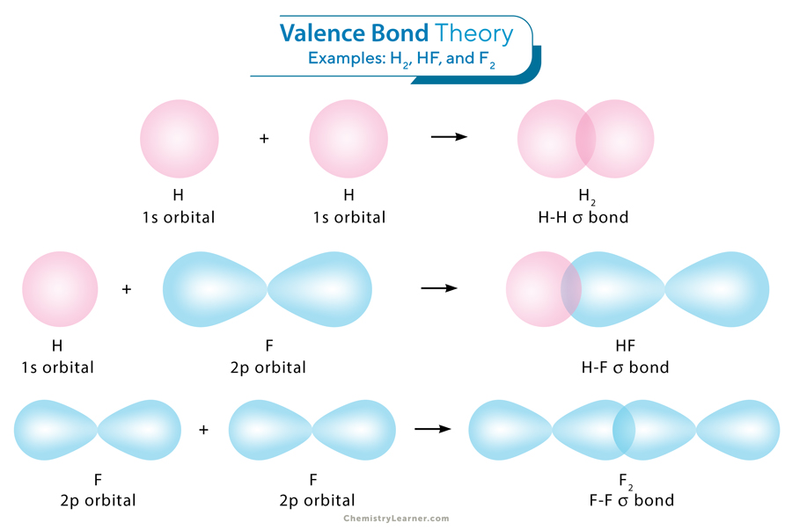

Valence bond theory (VBT)
Valence Bond Theory explains bonding through hybridization of metal orbitals.
Ligand electrons pair with vacant hybrid orbitals on the metal.
Predicts geometry and magnetic properties.
Types of hybridization:
  sp³ → tetrahedral (e.g., [Zn(NH₃)₄]²⁺)
  dsp² → square planar (e.g., [Ni(CN)₄]²⁻)
  d²sp³ → octahedral (e.g., [Co(NH₃)₆]³⁺)
Limitations:
Cannot explain color, spectra, or difference between weak/strong field ligands.
Over-simplifies metal–ligand interactions.

Slide 5
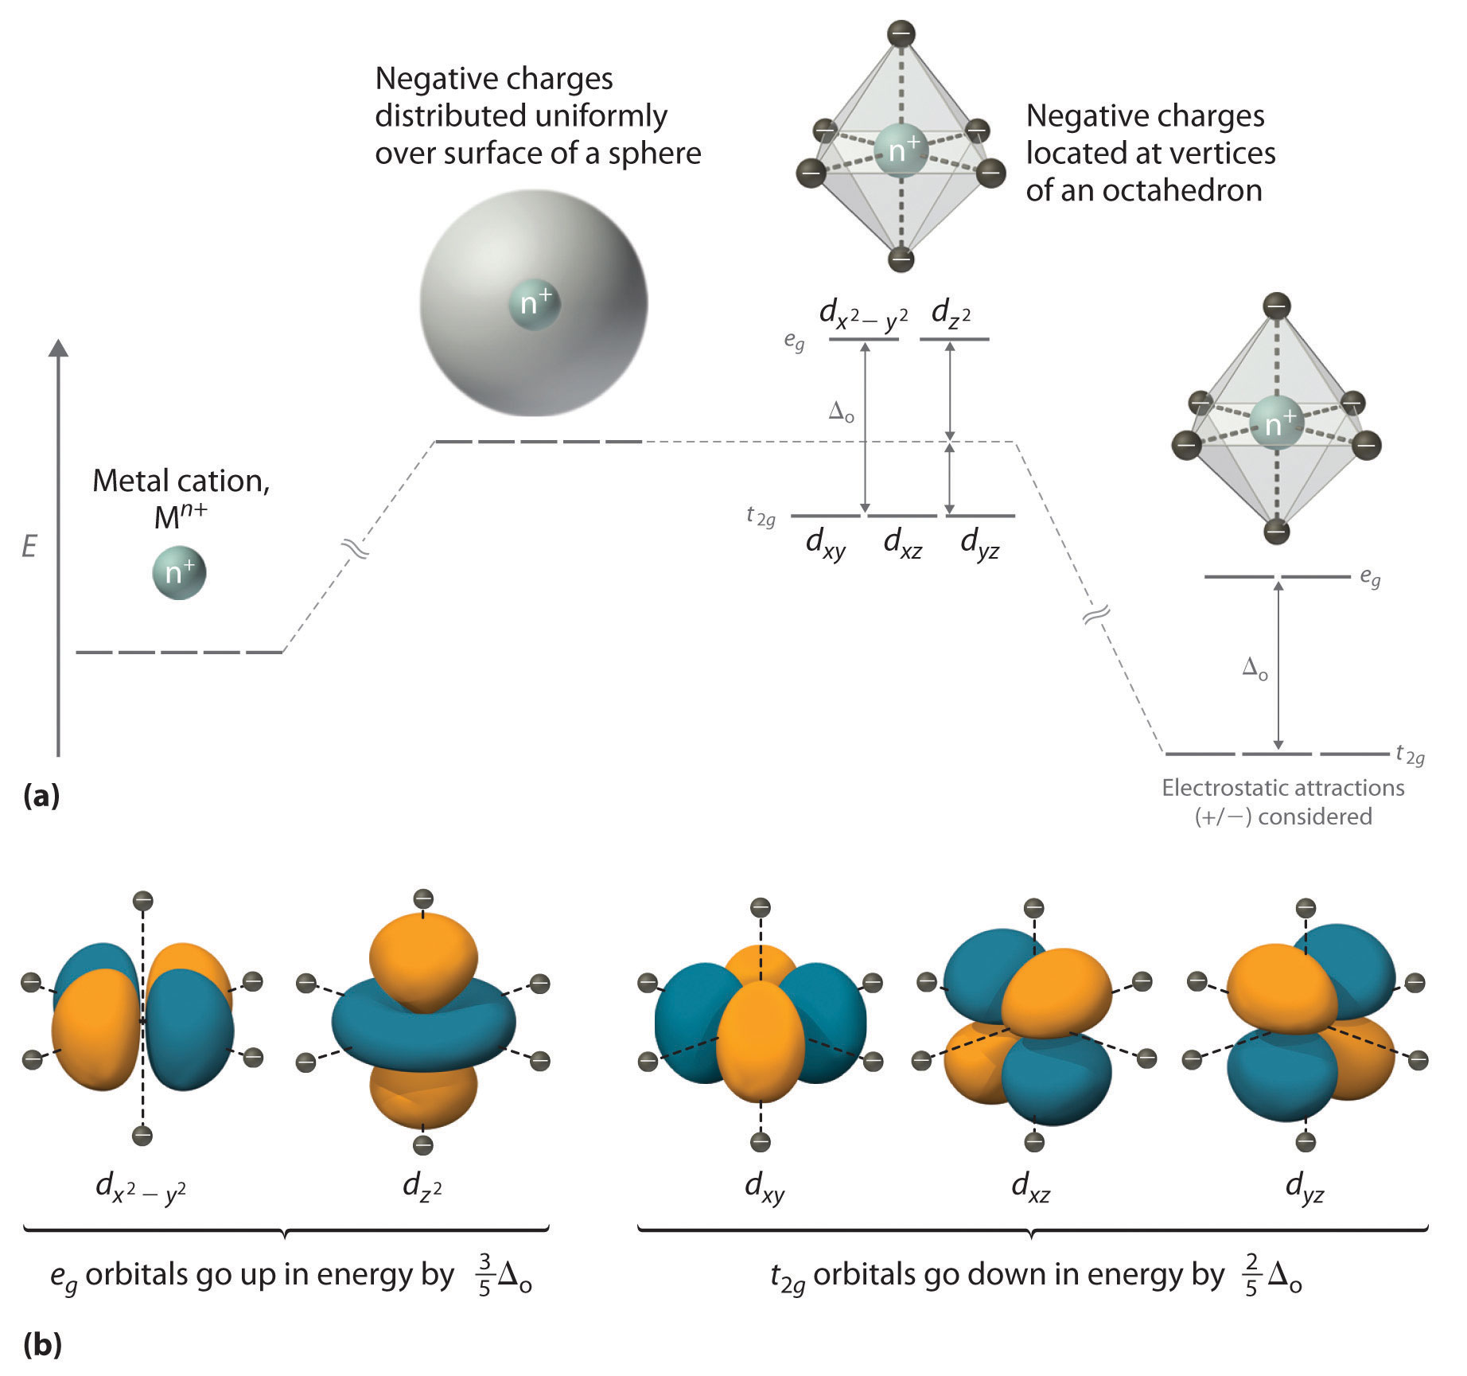
Crystal field theory (CFT)
CFT treats metal–ligand interaction as purely electrostatic.
Main Ideas:
Ligands act as point charges (or dipoles) that split the metal d-orbitals.
The energy difference between split orbitals = Crystal Field Splitting Energy (Δ).
Examples:
Octahedral field: d-orbitals split into t₂g (lower) and e_g (higher) sets.
Tetrahedral field: opposite splitting, smaller Δ.
Consequences:
Explains color (d–d transitions), magnetic behavior, and stability.
Strong field ligands (e.g., CN⁻) cause low-spin complexes; weak field (H₂O, Cl⁻) → high-spin.

Slide 6
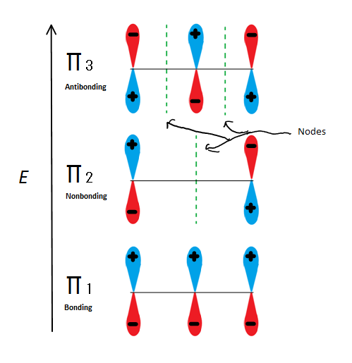
Molecular orbital theory (MOT)
MOT provides a more accurate quantum mechanical model of bonding.
Features:
Considers overlap of metal d, s, p orbitals with ligand orbitals.
Describes both σ-donation and π-backbonding simultaneously.
Predicts bond order, magnetic moment, and spectra more precisely than CFT or VBT.
Example:
In [Fe(CO)₆]²⁺, CO donates lone pairs (σ-donation) and accepts electrons into π* orbitals (π-backbonding).
→ Strong bonding, low-spin, colorless complex.

Slide 7
Covalent character and bonding strength
Bond character in coordination compounds varies between ionic and covalent.
Influencing Factors:
Metal oxidation state: Higher charge → more covalent.
Ligand type: Hard ligands (F⁻, H₂O) → ionic; soft ligands (CO, CN⁻) → covalent.
Metal size: Smaller radius → stronger covalent overlap.
Electronegativity difference: Smaller difference → more covalent.
Trends:
3d metals: moderate covalent bonds.
4d, 5d metals: more covalent due to orbital expansion.
Lanthanides/actinides: partly covalent with f-orbital participation.

Slide 8
Key points
Coordination bonding involves metal–ligand σ and π interactions.
Valence Bond Theory explains geometry through hybridization.
Crystal Field Theory interprets electronic structure and color.
Molecular Orbital Theory unifies σ- and π-bonding in one framework.
Bond strength and type depend on metal charge, size, and ligand nature.
Coordination bonding is a synergic interaction—ligands donate electrons to the metal, and the metal can back-donate electrons into ligand orbitals, stabilizing the complex.
The chemical bonds in coordination compounds reveal the rich interplay of electrostatics, covalency, and orbital overlap. Understanding these interactions allows chemists to predict geometry, color, magnetism, and reactivity of metal complexes, forming the foundation of inorganic and bioinorganic chemistry.

Slide 9
Thank you for attention!

